Slide 1

GitHub intro
Jan 2020

Slide 2
Welcome & Agenda
1
Zeta notebook and Hermes VDM
2
Tableau Hermes connection and data mover
3
GitHub introduction

Slide 3
1.Zeta notebook and Hermes VDM

Slide 4
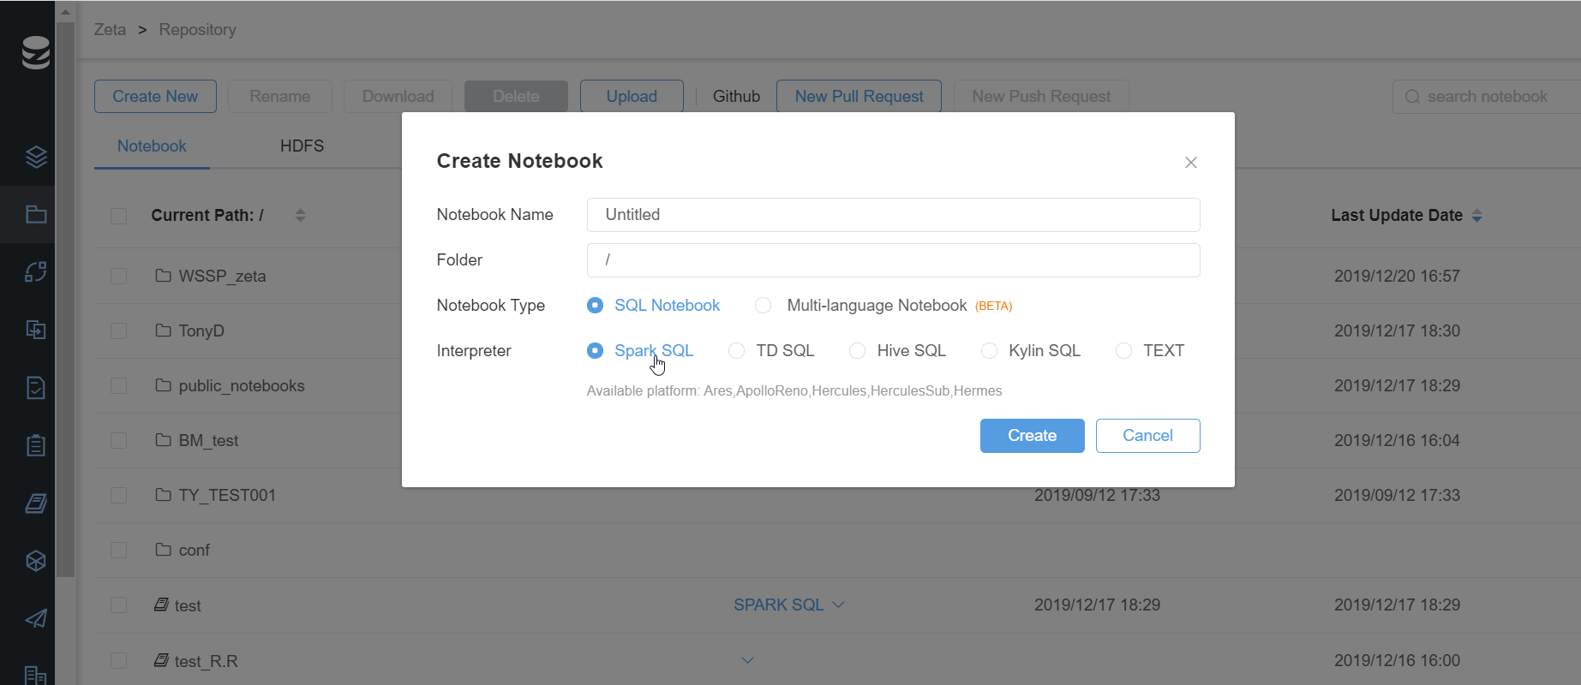
Zeta notebook
https://zeta.corp.ebay.com/zeta/#/notebook

Slide 5
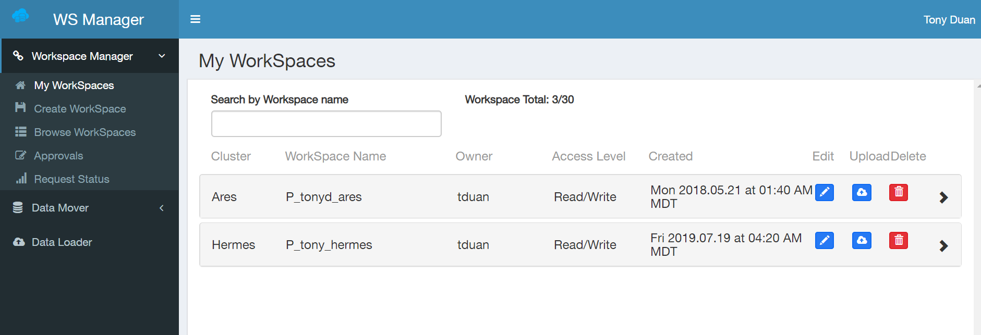
Hermes VDM
https://workspaces.corp.ebay.com/

Slide 6
2.Tableau Hermes connection and data mover

Slide 7
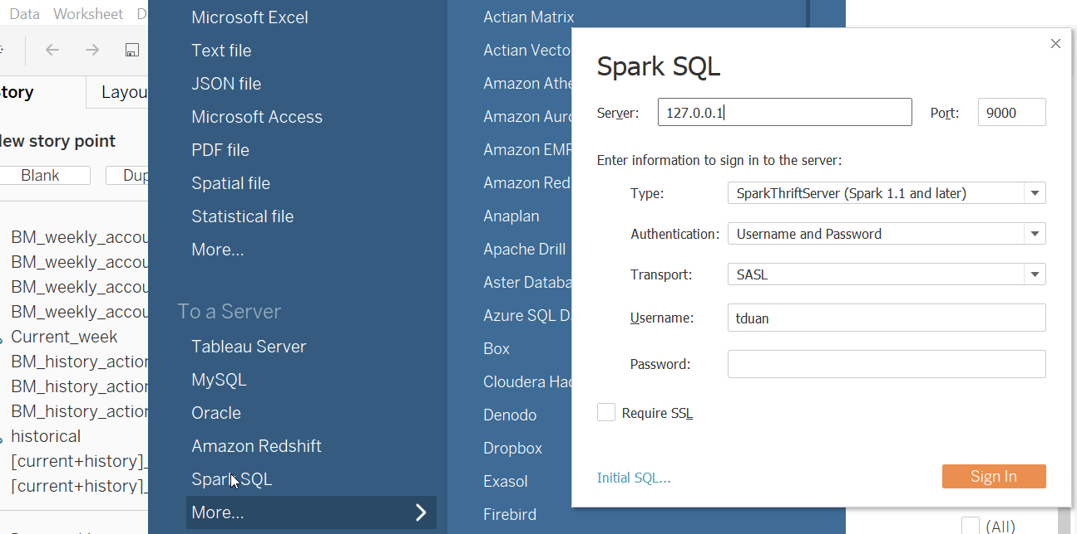
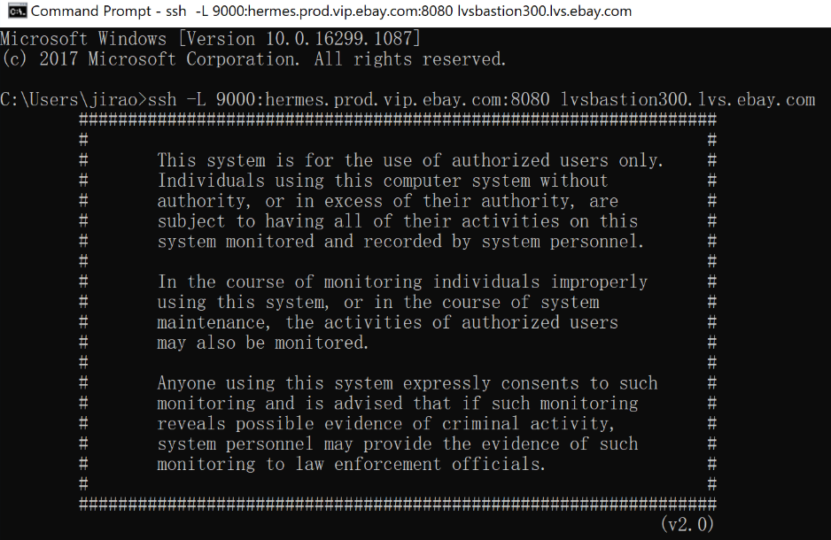
Tableau Hermes connection
https://wiki.vip.corp.ebay.com/display/CAC/201.+Migrate+report+to+Hermes#id-201.MigratereporttoHermes-Python
1. Download Tableau 2019 version on software center
2. Download Tableau spark SQL diver (https://www.tableau.com/support/drivers)
3. Connect hermes.prod.vip.ebay.com:8080 lvsbastion300.lvs.ebay.com on Putty

Slide 8
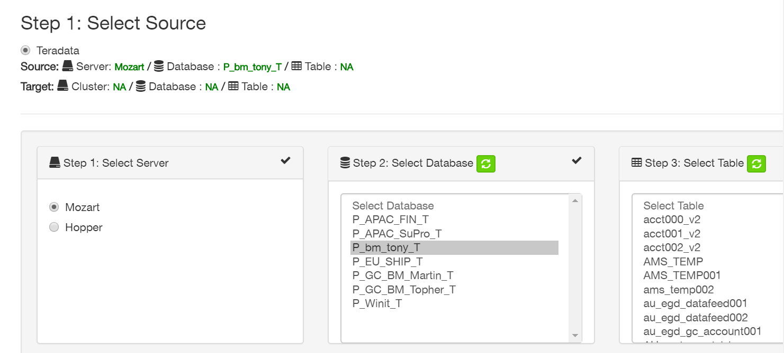
Data mover on workspace
https://workspaces.corp.ebay.com/create-data-move

Slide 9
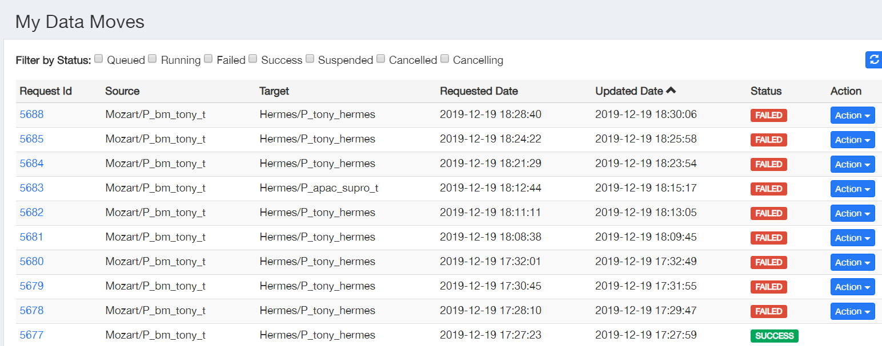
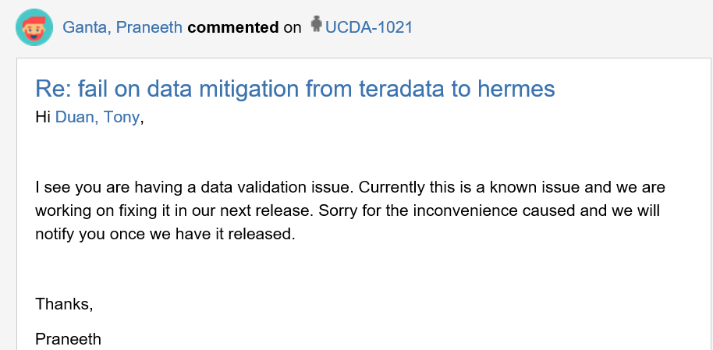
Data mover on workspace
https://workspaces.corp.ebay.com/create-data-move
If fail , try to delete column which have empty file
If still fail, try to open a Jira ticket

Slide 10
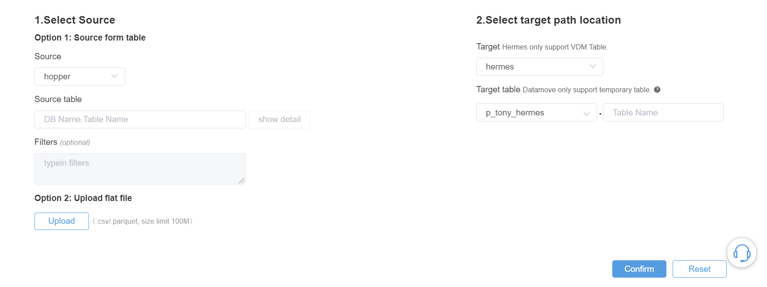
Data mover on Zeta
https://zeta.corp.ebay.com/zeta/#/notebook

Slide 11
3.Github introduction

Slide 12
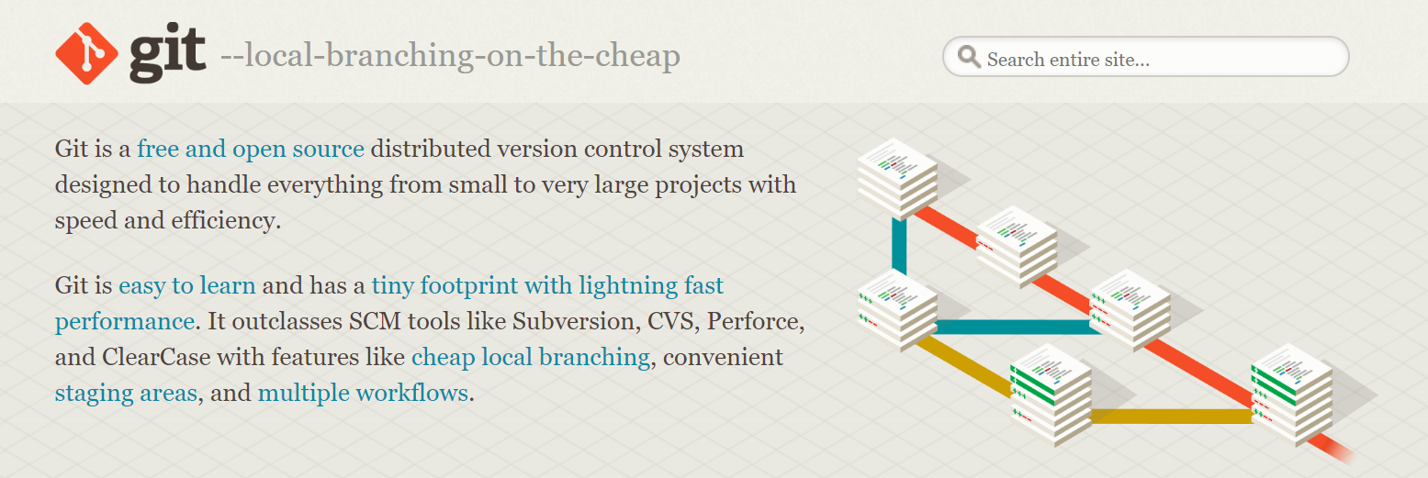


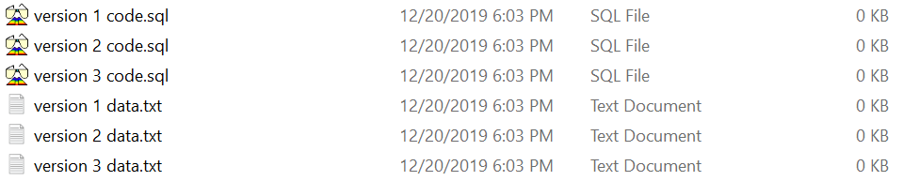
Git introduction
https://git-scm.com/
NO Git
With Git

Slide 13



GitHub introduction
https://github.com/
https://github.corp.ebay.com/
NO Git
With Git

Slide 14

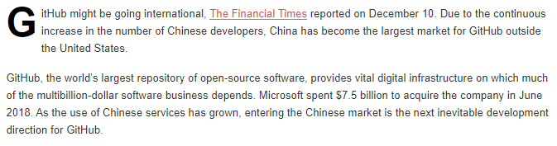
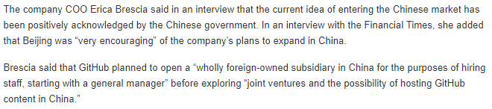
GitHub introduction

Slide 15
GitHub introduction
My GitHub account:
https://github.com/TonyFly3000/Object_detection_shiny
996 GitHub account:
https://github.com/996icu/996.ICU
My crop GitHub account:
https://github.corp.ebay.com/tduan/WSSP
My crop team GitHub account:
https://github.corp.ebay.com/bm-team/test1
ex ebayer crop GitHub account:
https://github.corp.ebay.com/magardner

Slide 16
GitHub introduction :commit(save) system
You can download any time snapshot from any branch and the new commit will be at the end of the branch
Master Branch
Repo A
Branch test1
Branch test2
Account
Repo B
commit
Repo C

Slide 17
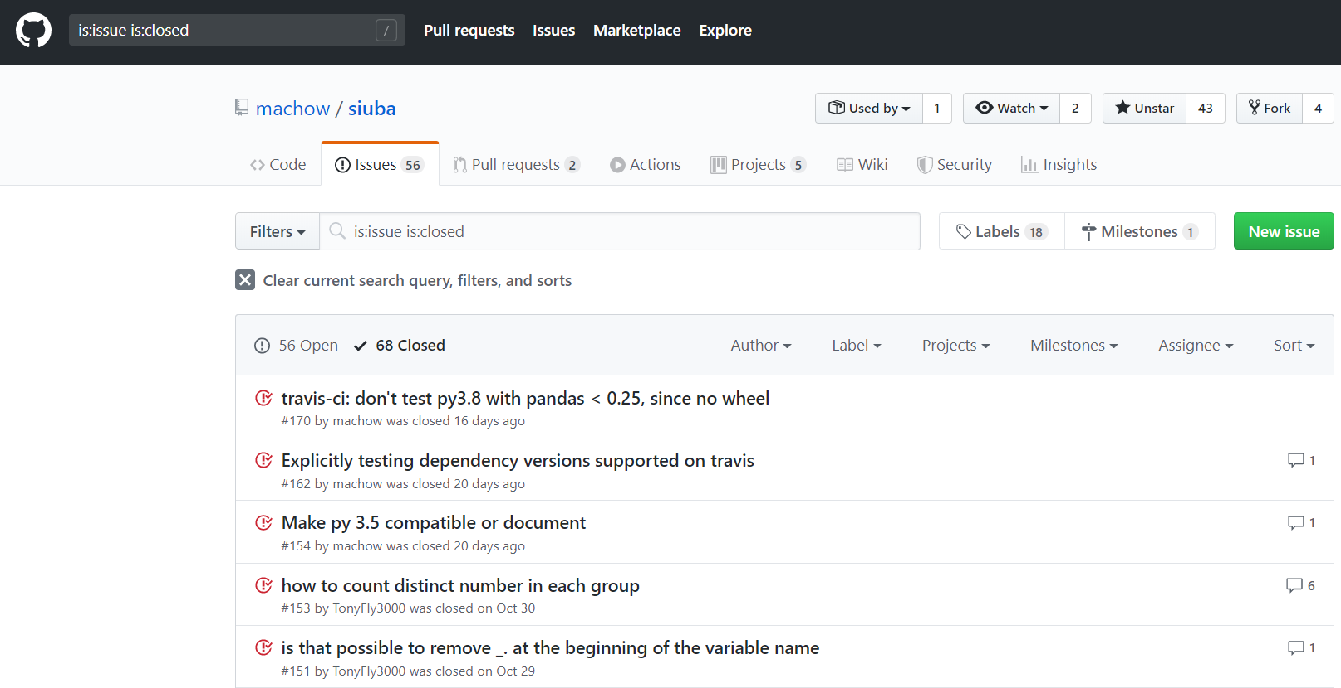
GitHub introduction :issue system
https://github.com/machow/siuba/issues/153

Slide 18
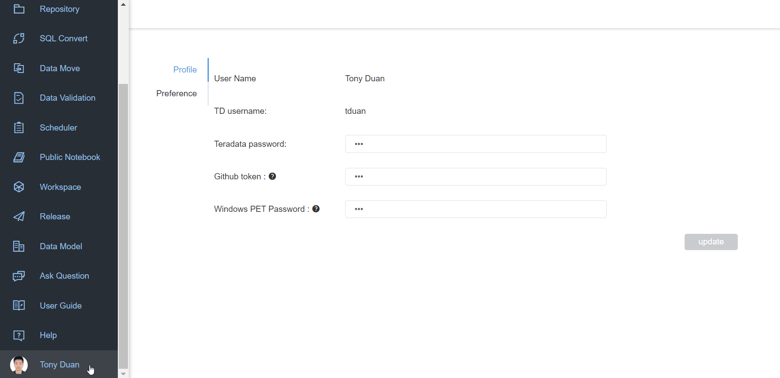
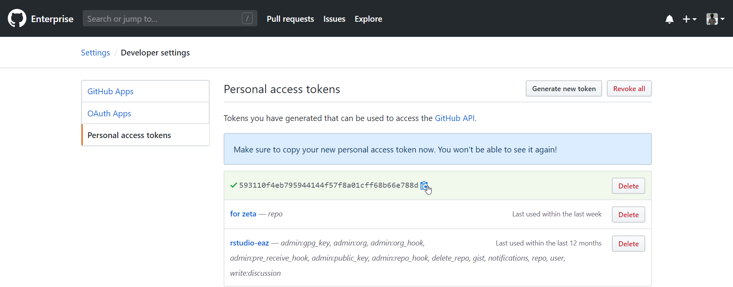
GitHub with Zeta set up tokens
https://zeta.corp.ebay.com/zeta/#/notebook
https://github.corp.ebay.com/

Slide 19
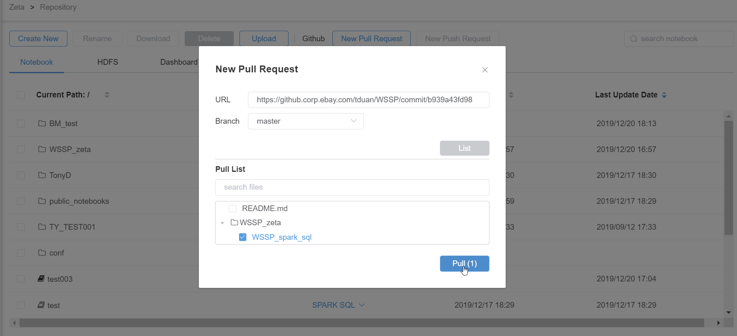
GitHub with Zeta pull (download) from GitHub
https://github.corp.ebay.com/tduan/WSSP

Slide 20
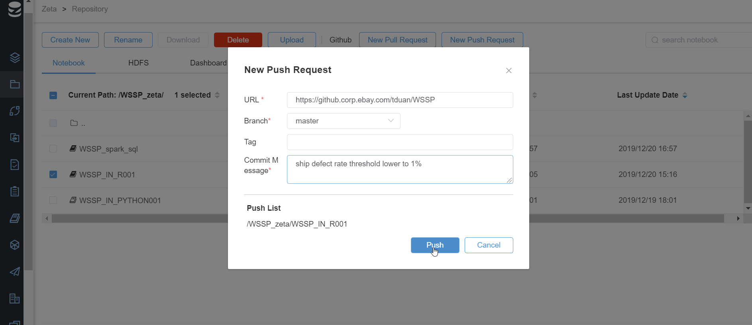
GitHub with Zeta commit(upload) to GitHub
https://github.corp.ebay.com/tduan/WSSP

Slide 21
Life is short . Let’s fork ! Thank you

